Slide 1
5.4 AI Communication Protocols
Teoh Teik Toe
ITOM/NBS
ttteoh@ntu.edu.sg
97905202

Slide 2



Whatsapp: 65-97905202
Wechat: TeohTeikToe
LinkedIN https://www.linkedin.com/in/teohteiktoe

Slide 3
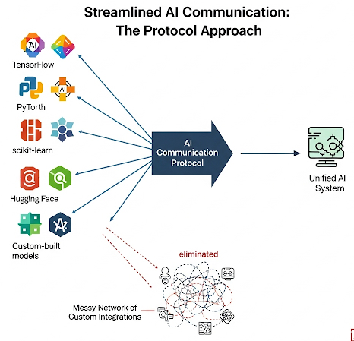
What are AI Communication Protocols?
Standardized sets of rules and formats (JSON schema) that enable different AI systems, agents, and external tools to interact and exchange information effectively.
They are the "languages" that allow for a cohesive, scalable AI ecosystem. Instead of a messy network of custom integrations, protocols create a unified way for AI components from different frameworks to work together.

Slide 4
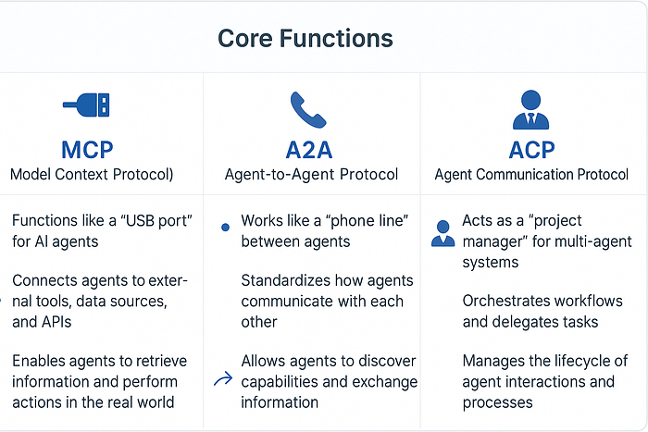
MCP vs A2A vs ACP

Slide 5
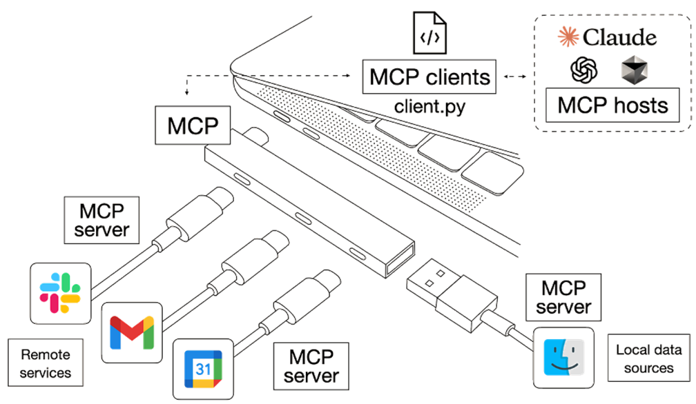

Model Context Protocol (MCP)
Further Reading: 1. Introducing the Model Context Protocol, 2. What is the MCP and how does it work?, 3. List of Awesome MCP Servers, 4. MCP Official Website

Slide 6
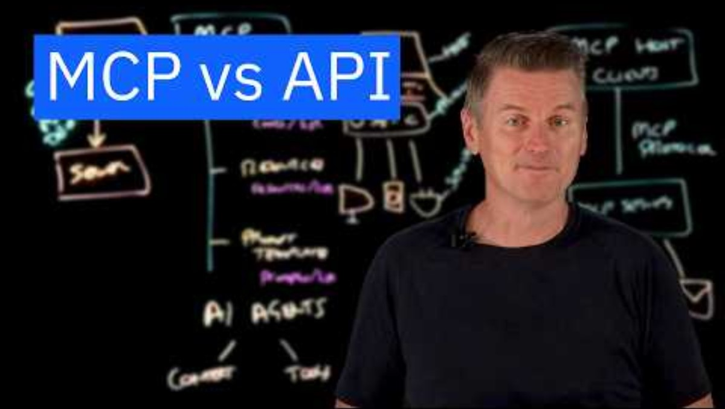
MCP vs API

Slide 7
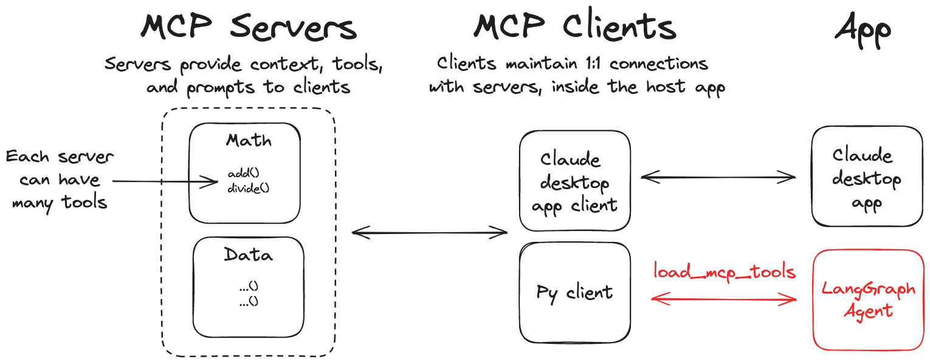
MCP in LangGraph
LangGraph agents can use tools defined on MCP servers through the langchain-mcp-adapters library.
Further Reading: Use MCP in LangGraph

Slide 8

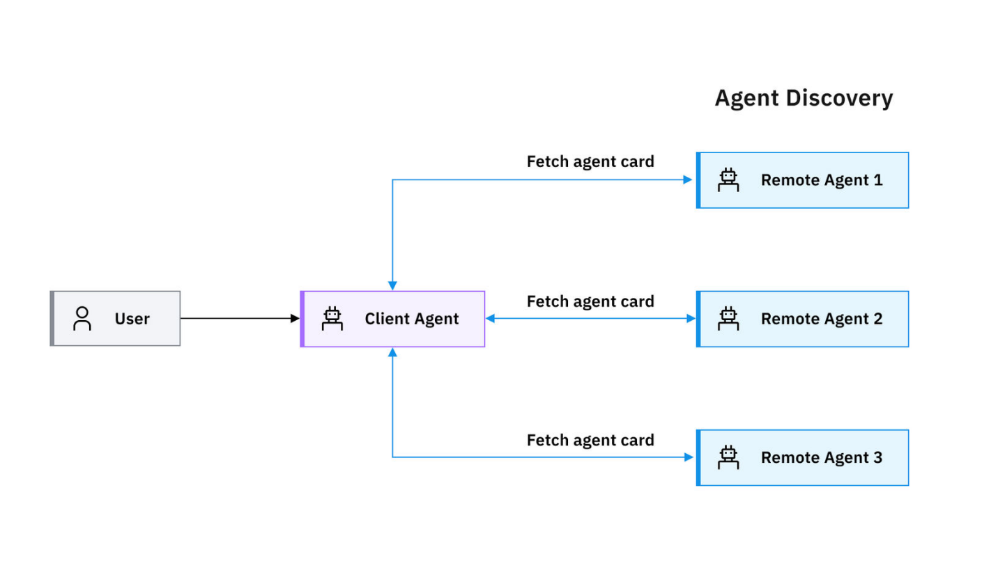
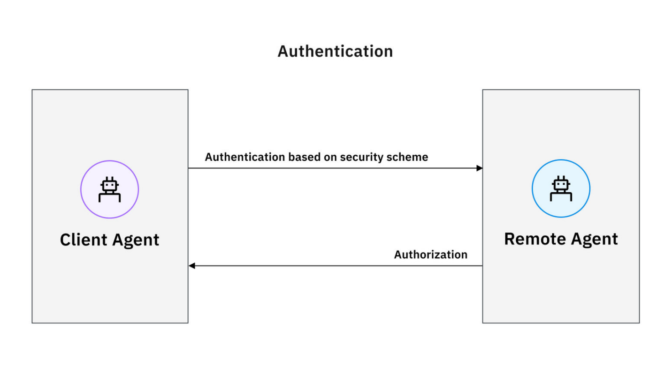

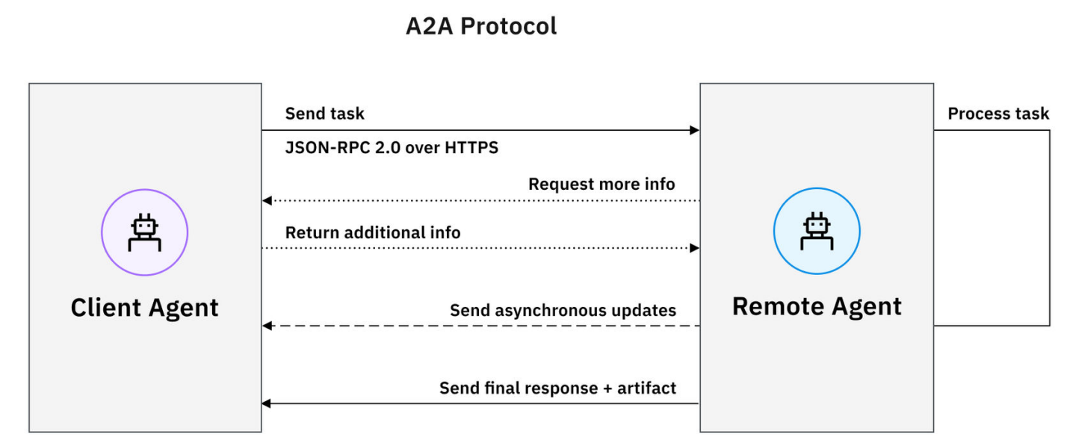
Agent-to-Agent (A2A) Protocol
Further Reading: 1. Announcing the Agent2Agent Protocol (A2A), 2. An overview of how A2A works in practice, 3. Github Repository

Slide 9

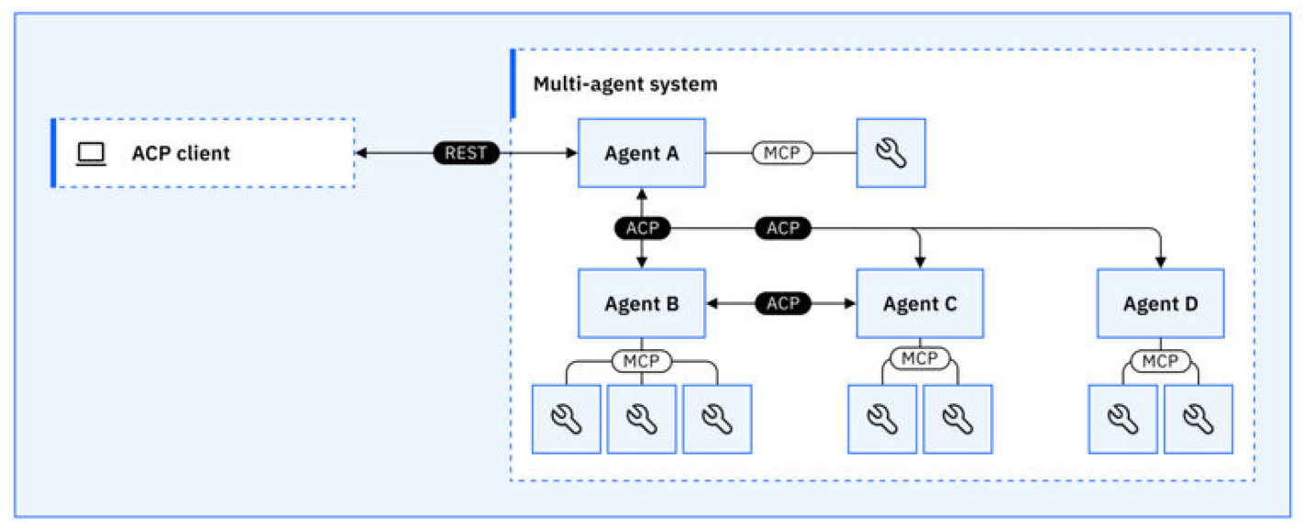
Agent Communication Protocol (ACP)
Further Reading: 1. What is Agent Communication Protocol (ACP)?, 2. ACP: Official Documentation

Slide 10
Advanced AI Communication Protocols
Protocol | What it is | Analogy | Best For
Agora | A framework that allows agents to negotiate and agree on which communication protocol to use. | An Auction House for Protocols: Agents can autonomously decide which protocol is best for a given task. | Creating a self-organizing ecosystem of agents that can adapt their communication to the situation.
ANP | Aims to create a decentralized, open network of all AI agents. | The Internet of Agents: A foundational protocol for a vast, autonomous network. | Building a large-scale, decentralized AI ecosystem with no central authority.
AGP | A high-performance protocol for fast, low-latency agent messaging. | A High-Speed Gateway: Ensures quick, secure, and reliable data flow for time-sensitive tasks. | Real-time applications, such as a self-driving car communicating with a smart city grid.

